Slide 1
Electronic Prescriptions for Controlled Substances (EPCS)
National Sales Meeting, 2015
Notes:
Good morning and welcome!
Today we are going to talk about EPCS and show you how Quest Diagnostics is staying current with the latest technology solutions for our clients.

Slide 2
NY State Law
Amendments to Title 10 NYCRR Part 80 Rules and Regulations on Controlled Substances have been
adopted and became effective as final regulations on March 27, 2013. The amendments authorize a
practitioner to issue an electronic prescription for controlled substances in Schedules II through V and
allow a pharmacist to accept, annotate, dispense and electronically archive such prescriptions.
New York Education Law Article 137 §6810 requires that all prescriptions be transmitted
electronically two years from the Department of Health’s promulgating regulations allowing for the
electronic prescribing of controlled substances. Utilizing modern prescription technology has the
potential to minimize medication errors for patients in New York State. Electronic prescribing also
allows for the integration of prescription records directly into the patient’s electronic medical record.
Electronic prescribing has the potential to reduce prescription theft and forgery.
Notes:
What is EPCS, why is NY making this mandatory, pharmacies onboard?
Here is a little background on the New York State Law with regard to electronically prescribing controlled substances.
In summary, the amendment became effective March 27, 2013 and NY gave their physicians and pharmacies two years to get a solution in place for prescribing Sch II-V meds.
Reducing prescription thefts, minimizing errors, and working to eliminate prescription forgery are the main goals for this amendment.

Slide 3
Resources for the NY State Law
DEA Website:
http://www.deadiversion.usdoj.gov/ecomm/e_rx/faq/faq.htm NY EPCS FAQs:
https://www.health.ny.gov/professionals/narcotic/electronic_prescribing/docs/epcs_faqs.pdf NY Electronic Prescription Requirements for the System:
https://www.health.ny.gov/professionals/narcotic/electronic_prescribing/requirements.htm
Notes:
Listed are helpful resources supplied by NY with regards to this mandatory requirement.

Slide 4
Mandatory Electronic Prescribing
Effective March 27, 2015
“Electronic prescribing is a paperless process.
A prescription generated on an electronic system that is printed out to the Official New York State Prescription form or faxed is NOT an electronic prescription.”
- New York State Department of Health
Bureau of Narcotic Enforcement
Notes:
This statement is posted on the DEA website
As of March 27, 2015 it will be mandatory for practitioners, excluding veterinarians, to issue electronic prescriptions for controlled and non-controlled substances.
In case of technical failure, there is a manual prescribing backup process in place.

Slide 5
EPCS Enrollment
Notes:
So, how does a physician get his office started?

Slide 6
EPCS Users
Let’s first understand the EPCS users in an Organization:
EPCS Admin – a staff member, other than a phlebotomist, that serves as an administrator for their organization’s EPCS users, and performs duties such as nominating registrants or assigning the Admin or Approver role to other users
Registrant – a staff member who has DEA & NPI, nominated by an EPCS Admin in order to complete registration with the Credential Service Provider (CSP) Exostar®
EPCS Approver – staff member who has already completed EPCS registration, and is responsible for giving final approval to EPCS registrants in their organization
EPCS Approved Prescriber – staff member who has completed registration and received final approval from their organization's EPCS Approver, and is authorized to prescribe controlled substances electronically
Notes:
First, we need to understand the users or players in this process.
[click to display each of the four users]
[Read the users listed in the bulleted list]

Slide 7
Becoming an EPCS Admin
There are two methods for becoming an EPCS Admin. A user can assign the role to themselves, or be assigned the role by another ECPS Admin in their organization.
To assign the Admin role to themselves, the user should:
Login to Care360 Labs & Meds
From the Message Center, click EPCS, and then click the link to read and accept the EPCS Admin agreement
After accepting the agreement, the Manage EPCS link becomes available from Admin menu
To assign the EPCS Admin to another user, the Admin should:
Login to Care360 Labs & Meds
From the top of the application, click Admin > Mange EPCS to search for a user and assign the Admin role
Notes:
[read slide]
Both of these methods can be accomplished from within Care360 L&M

Slide 8
Becoming an EPCS Approver
An EPCS Approver is responsible for giving final approval to prescribers within their organization who have completed registration with Exostar®.
In order to be given the Approver role, they must have completed the registration process themselves.
To give final approval to another prescriber, the EPCS Approver should:
Login to Care360 Labs & Meds
From the top of the application, click Admin > Mange EPCS to search for a user and complete steps to approve them
Notes:
[Read to slide]

Slide 9
Registration Process for Prescriber
Registrant:
EPCS Admin nominates Registrant and notifies him
From the Message Center, the registrant clicks EPCS to access the Getting Started with EPCS page
Registrant clicks one of the following:
Link to order the required one-time password (OTP) hardware token, or if they already have token, then…
Link to register and activate their OTP token
NOTE: Providers are required to purchase a token from Exostar® in order to complete registration, as well as use the token for digitally signing prescriptions for controlled substances. Exostar mails the token to the provider.
Follows the steps to register with Exostar®
EPCS Approver within their organization gives final approval
Notes:
[Read to slide]

Slide 10
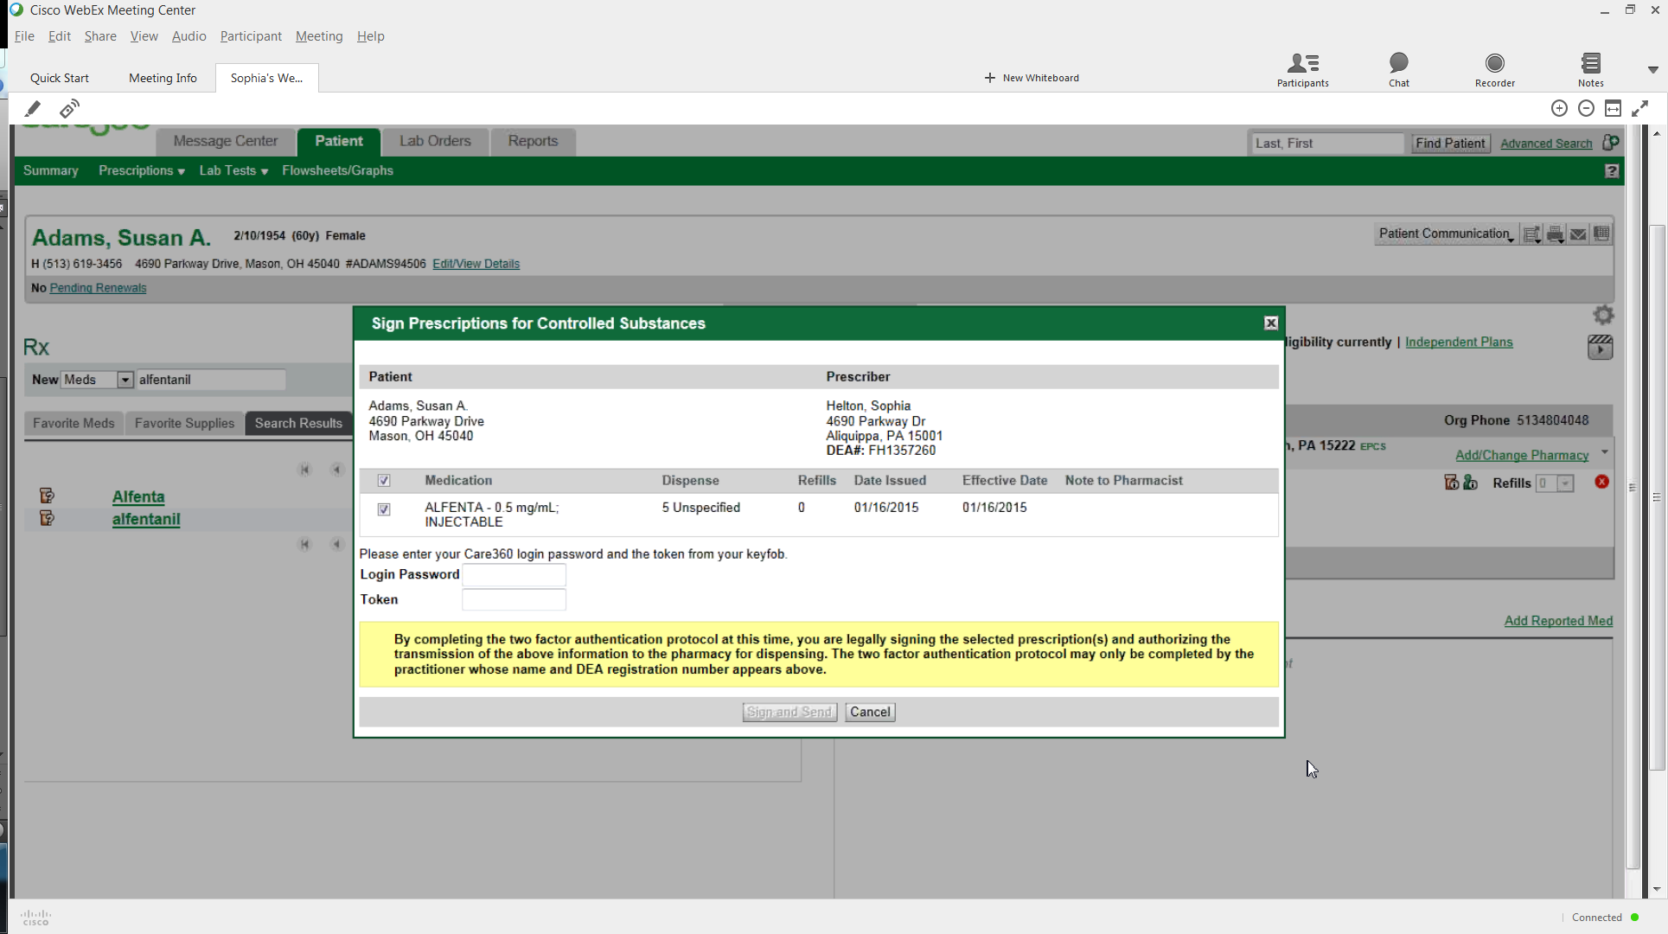
Provider Workflow
Provider logs in to Care360 Labs & Meds, locates patient
Click on Write a Prescription link
Select provider if needed
Select CII medication
Select pharmacy with EPCS initials after
Click Approve All
Sign Prescriptions dialog box displays <Fig.1>
Enter Care360 login password and the token number
Click Sign and Send
Prescription complete notification displays
Fig.1
Notes:
[Read to slide]

Slide 11
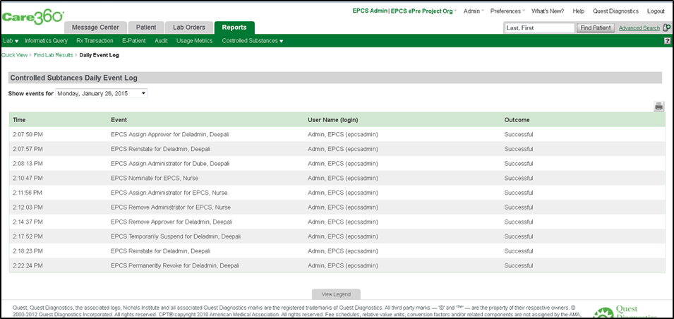
Controlled Substances Report
Reports Tab
“Controlled Substances”
Daily event log for the client to monitor <Fig.2>
Fig.2
Notes:
A new report is available from the Reports tab
Reports will be available for the client to monitor
Internal reports that need to be monitored to by Quest Diagnostics to maintain certification

Slide 12
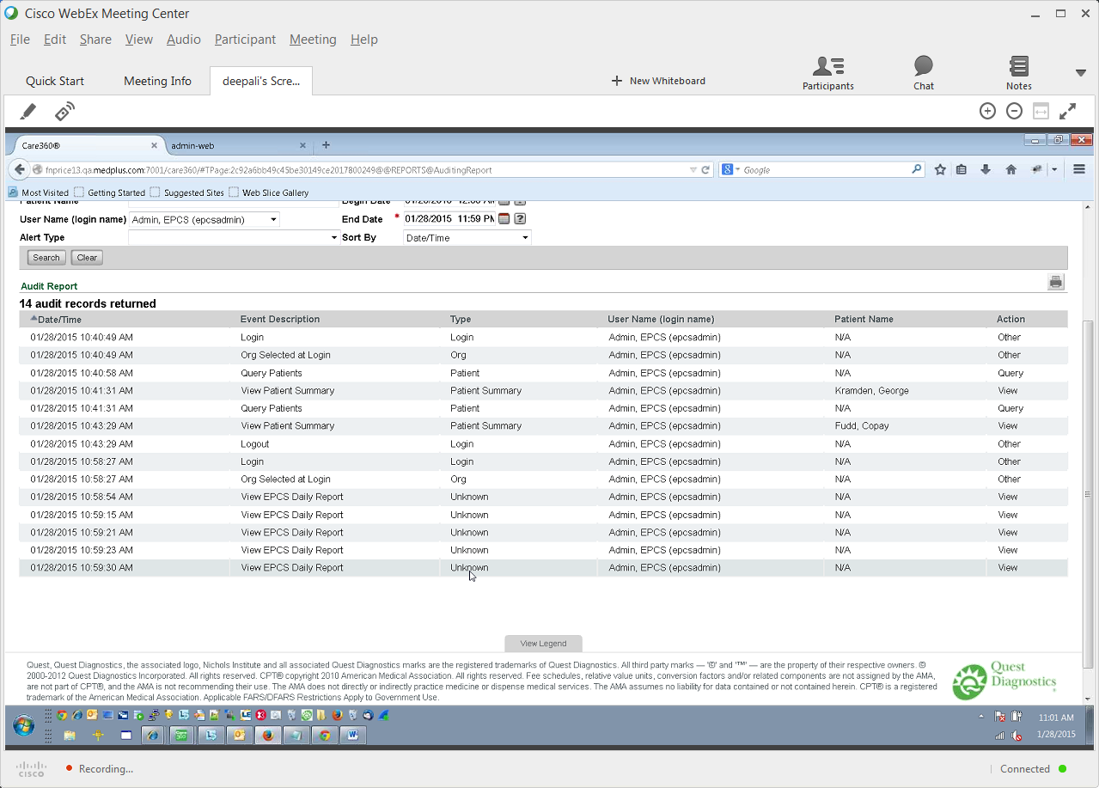
Audit Report
Reports Tab
Audit
Audit report is available <Fig.3>
Fig.3
Notes:
A new report is available from the Reports tab
Reports will be available for the client to monitor
Internal reports that need to be monitored to by Quest Diagnostics to maintain certification

Slide 13
“WIIFM”
“What’s in it for Me”
Notes:
Who knows what this acronym stands for?
<audience gives answers>
[click to display the definition]
WIIFM is a training technique that we use to connect the client with the learning. “How is what you are showing me going to benefit my practice”?
As our healthcare progresses, Quest Diagnostics is keeping up with the demands! So, let’s point out why they should be interested in our product, what we can do for them!
On the next slide we will take a look at the benefits of EPCS

Slide 14
EPCS Certified Product
Once again Quest Diagnostics is at the forefront with solutions for the healthcare community.
Our EPCS prescribing feature increases confidence with our existing customers in NY
Can potentially generate new revenue by signing up new ePrescribing accounts in the state of NY
Provider benefits include:
Reducing prescription thefts
Working to eliminate prescription forgery
Notes:
[read slide]
This feature is only being turned on in the state of New York, but it will be available to other states when required by checking a box!
We are still 1 week out on final development and the features and process that you have viewed today may change slightly. GA is currently scheduled for March 15 provided we pass certification.
Stay tuned for more updates and training on demand!

Slide 15

Notes:
Thank you for your time!

